Slide 1
Object-Oriented Programming
What / Why OOP?
OOP Terminology
OOP in Python
Design Example
Encapsulation
Composition
Inheritance
Polymorphism
AKA: OOP

Slide 2
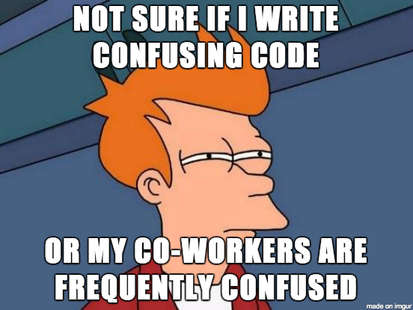
Why OOP?
Software Engineering is the real topic today.
Goal is to write code that is:
split into logical components
easy to understand
easy to use / re-use
easy to modify
easy to maintain
easy to test
Notes:
“As a Data Scientist you’ll be writing and using a lot of code. Good Software Engineering is the key to being efficient. Good OOP is the key to good Software Engineering.”

Slide 3
OOP is a programming paradigm
What is a “paradigm”?
Paradigm: a distinct set of concepts or thought patterns
Other programming paradigms:
Functional: no global state, deeply nested function calls
Imperative: explicit sequence of commands (often called sequential)
Procedural: like imperative, but also supports procedures (e.g., functions)
Declarative: declare the result you want, not how to obtain it (e.g. SQL)
…
Most programming languages offer a mix of paradigms.
Notes:
We should groud what OOP is. Is it a language? No. Is it a library? No. It is a programming paradigm. Define paradigm. Talk about other programming paradigms.
Some language borrowed from:
https://en.wikipedia.org/wiki/Paradigm
http://cs.lmu.edu/~ray/notes/paradigms/

Slide 4
What’s in a program?
“A program by any other name would smell as sweet.” - Shakespeare’s Juliet
Program = Data + Algorithm
For this presentation, we’ll say:
Program = State + Behavior
Notes:
Don’t get the joke? See: https://en.wikipedia.org/wiki/A_rose_by_any_other_name_would_smell_as_sweet
Btw, it’s a bad joke. No one ever laughs. But I think it’s funny so I’m leaving it!
But seriously, what IS in a program? A program is data + algorithms to manipulate the data. Data by itself is kinda lame and not useful. An algorithm by itself is also kinda lame and not useful. But when you combine data with algorithms, that’s when we WIN.
But THIS presentation we will say a program is state and behavior. The state is the data. The behavior is the algorhtm. “State” and “Behavior” are terms from the OOP world.

Slide 5

So, what is the OOP paradigm all about?
Group the program’s state and behavior inside objects and classes.
Inspired by how humans categorize and manipulate the physical world.
E.g. Consider the concept of “Mug”:
Mug has state: color, volume, location
Mug has behavior: drink, fill, refill, break, clean
What is the current state of this mug?
Notes:
So, all programs have state and behavior. That’s what we just talked about.
OOP is all about how to organize that state and behavior! It puts the state and behavior into objects and classes in a way that roughly mirrors the physical world.

Slide 6




OOP Terminology: “Object”
An object is:
A collection of variables (the “state” of the object)
A collection of methods (the “behavior” of the object)
There are 5 “Mug” objects on this page. Each has distinct state, but the same behavior.
Notes:
Here are five mug objects. I’m calling them objects. They are distinct objects. Each has its own state (color, size, location, etc). Each also has some behavior it can do. Interesting… the behavior of each of these objects is similar (the same, perhaps). They are all fillable, drinkable, breakable, washable. Interesting. It’s like we should have a meta concept for these objects. Maybe we’ll name that meta object “Mug”. So all these objects are of the same meta object which we named “Mug”.

Slide 7
OOP Terminology: “Class”
A class is a “blueprint” for objects. It’s the meta concept.
E.g. The previous slide showed 5 mug objects. Each of those 5 objects is an instance of the class: Mug. 5 objects, 1 class.
Notes:
That brings us to the idea of a “class”. The class is the meta concept. “Mug” from the previous slide. It can be thought of as a blueprint for objects. We only have one Mug class, and from that meta concept we can build ourselves as many mug objects as we want.

Slide 8





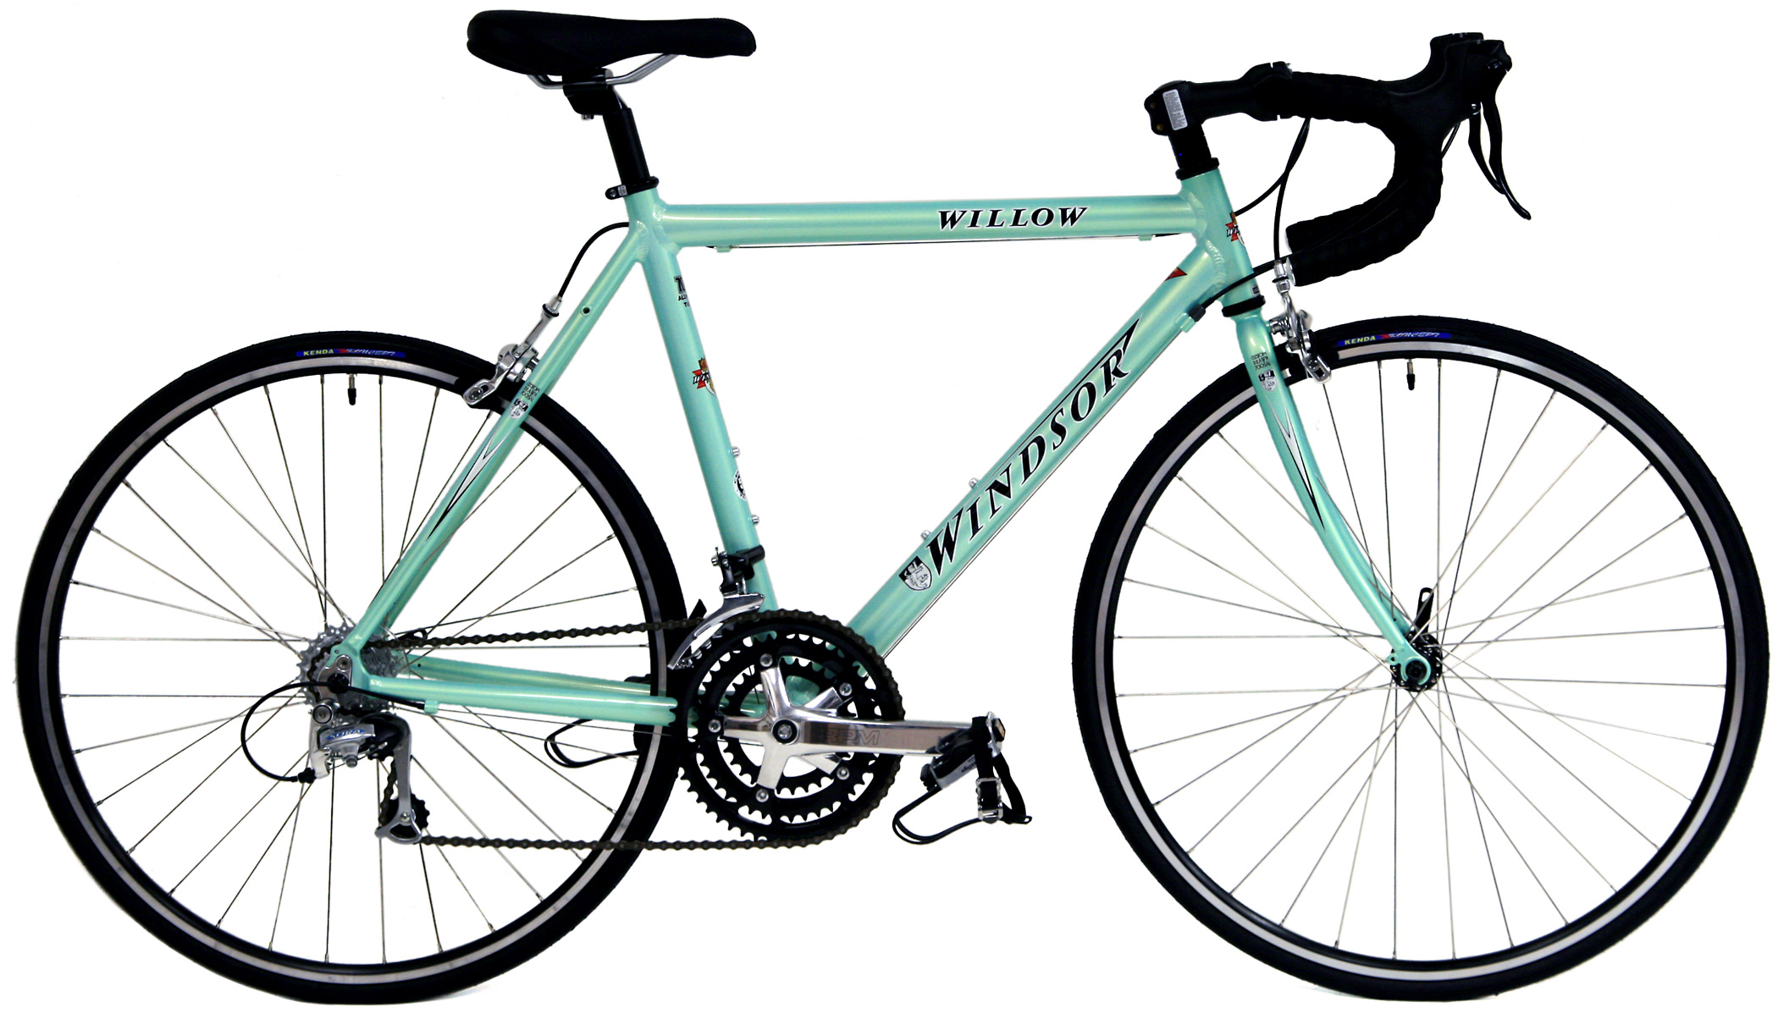



How many objects? How many classes?
Notes:
DO AN IN-CLASS POLL HERE TO CHECK FOR UNDERSTANDING! We poll on polleverywhere.com
The student usually all (or mostly) agree that there are 3 classes and 9 objects.

Slide 9
OOP Terminology: “Member variable”
Every object has a set of member variables. Member variables are variables that are bound to that object and only that object. You can think of it like that object “owns” those variables.
An object’s member variables define that object’s current state.
Notes:
Member variables go by many names, other people call them: “instance variables”, “fields”, “attributes”, “properties”, etc. I don’t really care what you call them.

Slide 10
OOP Terminology: “Method”
Every object has a set of methods. Each method is a procedure that the object knows how to perform. Most of the time the methods will change the object’s state (i.e. modify the object’s member variables).
An object’s methods define that object’s behavior.
Usually an object’s methods are defined by the object’s class, however in Python you can give an object new methods at runtime. That’s why we say methods belong to the object, not to the class.
Notes:
In code, methods look a lot like functions. They act a lot like functions too! But please don’t call them functions, some people will get annoyed by that… technically procedures that operate on objects are called “methods”, while stored procedures that live outside of an object are called “functions”.

Slide 11
Live Python Demo: OOP in Python
Review:
Python classes you use every day! (list, dict, string, …)
Instantiating Fraction objects
Teach fractions how to add themselves together
Magic methods
Notes:
Look in the ‘demo1’ folder.
Start with something like what is in `review.py`. I usually just live-code this though. The point is to show that we’ve been using classes and objects already! Create a few lists, and point out that each list is an object with its own state. Point out that we only have one class rulling them all: list.
Then start a new file and type out `main.py`. Say, “Wouldn’t it be great if we had a Fraction class that knew how to store a rational number?” Type out the code and say, “Let’s pretend we have this Fraction class, and let’s pretend it works like this.” Run it. It breaks. Now fix each error you encounter by modifying `fraction.py`. Keep doing that until `main.py` runs!

Slide 12
UML Class Diagram
UML: Unified Modeling Language
Camera
What are the parts of this class diagram?
is_open : boolean
input_port : string
open(ctl_port : string)
close()
capture() : image
Notes:
We will only touch super-briefly on UML. We will hit “Domain Models” super-fast. Let’s name the parts...
(Note: Class diagrams usually denote the access policy (public, private, protected), of each member/method. But python doesn’t enforce access policies, so I’ve left them off the diagram.)

Slide 13
UML Class Diagram
UML: Unified Modeling Language
the class name
member variables
(the state of each object)
Camera
is_open : boolean
input_port : string
methods
(the behavior of each object)
open(ctl_port : string)
close()
capture() : image
Notes:
… these are the parts...

Slide 14
Let’s design a program in OO fashion.
Smart Recycling Robot (SRR)
Build a robot that sorts physical objects into three categories:
recycle,
compost,
landfill
The robot brain is a computer program that you will write. The robot has an arm for grasping each piece of trash and delivering it to one of three bins.
Notes:
Knowing that, let’s design an application and use UML to brainstorm about how each class in our program will fit together. This is what UML is good for: brainstorming about class relationships, and also for communicating with your colleges your ideas about class relationships.

Slide 15
Software Engineering: Designing the SRR
Nouns and Verbs
Capture frames from the camera.
Process frames.
Move the arm into position.
Grasp the trash using the arm.
Release the trash.
Loop the detection/action cycle.
Types of trash are: Recycle, Compost, Landfill, Empty
Notes:
The first step (if you’re new to this) is to write down sentences about your program. Like these…
Then go back and identify the nouns and verbs in each sentence. This can get you started knowing what classes and methods need to exist. Nouns become class names, verbs become method names.

Slide 16
Software Engineering: Designing the SRR
UML Class Diagram with Relationships
sklearn.svm.SVC
DecisionModule
...
Camera
fit(X, y)
predict(X)
is_open : boolean
input_port : string
Arm
process(frame : image) : Trash
current_position : tuple
is_grasping : boolean
is_open : boolean
ctl_port : string
open(input_port : string)
close()
capture() : image
<<enumeration>>
Trash
Controller
open(ctl_port : string)
close()
move_to(new_position : tuple)
grasp()
release()
Recycle
Compost
Landfill
Empty
loop_once()
Notes:
We get this.

Slide 17
Software Engineering: Designing the SRR
UML Class Diagram with Relationships
sklearn.svm.SVC
DecisionModule
...
Camera
fit(X, y)
predict(X)
is_open : boolean
input_port : string
Arm
process(frame : image) : Decision
current_position : tuple
is_grasping : boolean
is_open : boolean
ctl_port : string
open(input_port : string)
close()
capture() : image
<<enumeration>>
Trash
Controller
open(ctl_port : string)
close()
move_to(new_position : tuple)
grasp()
release()
Recycle
Compost
Landfill
Empty
loop_once()
Notes:
Add relationships. Which classes need to know about which other classes?
Dashed arrow -- “uses”
Diamond arrow -- “composed of”
Notice the SVC is only held by the DecisionModule. That’s cool because it allows us to swap out the SVC for a different learning model by only updating the DecisionModule -- the change is very isolated and small. It gets even better... Later on, using polymorphism, we’ll be able to swap out the SVM by only changing one line of code!

Slide 18
Live Python Demo:
construct the SRR
OOP FTW in (at least) 3 ways: what are they?
Notes:
Look in the ‘demo2’ folder.
Show the files (in this order):
1. Hardware.py (stubbed out; Bob will work on this)
2. Decisions.py (stubbed out; Bill will work on this)
3. Controller.py (done; we’ll write a test for this during the afternoon excersise (btw, there’s a bug))
Now, write ‘main.py’ from scratch (see `main_solution.py`).
Takeaways: We turned our UML into code! And we stubbed out the hard parts so Bob and Bill can work on them in parallel and without stepping on each other’s toes. Cool.
OOP FTW reasons:
Our code is readable. New people to the project shouldn’t be too confused.
If one class gets complicated, the other classes don’t need to know about it. The complexity is hidden away.
Easy to test. Test each class one at a time. Testing each method one-at-a time is called “unit testing”, which is possible with this code.
Easy to modify. Say you get a new type of arm. Easy, just modify the one class: Arm. Or say you get an additional arm of the same type. Pretty easy too: just instantiate a new arm and update the Controller so that the second arm is also used.

Slide 19
Encapsulation
Hiding the confusing details/complexity of your code inside a class.
Good because:
Code outside the class is safe (encouraged, even) to ignore the details inside the class.
The details/complexity inside the class are free to change without affecting the code outside the class.
Notes:
How does the SSR use encapsulation? Tell me!

Slide 20
Encapsulation (example)
>>> import numpy as np >>> X = np.array([[-1, -1], [-2, -1], [1, 1], [2, 1]]) >>> y = np.array([1, 1, 2, 2]) >>> from sklearn.svm import SVC >>> clf = SVC() >>> clf.fit(X, y) >>> print(clf.predict([[-0.8, -1]]))
[1]
Notes:
There is a lot happening inside the SVC class, but we don’t have to know or care about it! We only reap the benefits.

Slide 21
Composition
Storing objects inside objects. The “has-a” relationship. Triangle has Points.
class Point: ... details omitted ... def calculate_distance(self, other_point): ... details omitted ...
if __name__ == '__main__': p1 = Point(0, 2) p2 = Point(4, 5) p3 = Point(3, 0) triangle = Traingle(p1, p2, p3) print triangle.calculate_perimeter()
class Triangle: def __init__(self, point1, point2, point3): self.point1 = point1 self.point2 = point2 self.point3 = point3 def calculate_perimeter(self): a, b, c = self.point1, self.point2, self.point3 return a.calculate_distance(b) + b.calculate_distance(c) + c.calculate_distance(a)
Notes:
How does the SSR use composition?

Slide 22
Morning Exercise
Modify an existing OOP-style program: The (card)game of WAR.

Slide 23









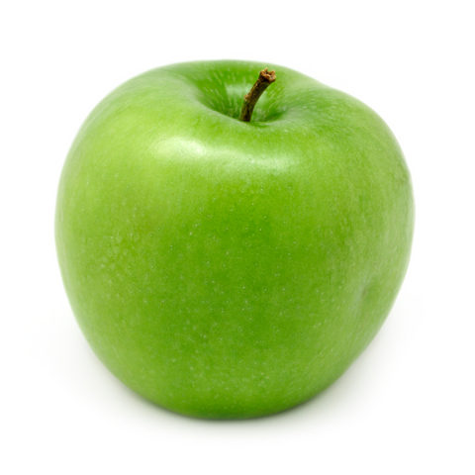


How many objects? How many classes?
Notes:
Object is easy: 12 object.
But classes? Uhh… maybe 1. Maybe 5… ? Poll the class. There will be controversy.

Slide 24
Inheritance
The “is-a” relationship. Banana is a Fruit.
This is a silly example, we’ll see a serious example next.
Fruit
weight : float
“Parent” class:
grow()
eat()
Banana
Orange
Apple
“Child” classes:
peel(percentage : float)
peel()
wash()
Notes:
Parent class is also called the “base” class.
Child classes are also called “subclasses”.
Notice the arrow seems backwards if you think “Banana is derived from Fruit.” While that statement is true, the arrow is not trying to capture that idea. Rather the arrow captures the idea “Banana is-a Fruit.”

Slide 25
Polymorphism
Fruit
weight : float
“Parent” class:
grow()
eat()
Banana
Orange
Apple
“Child” classes:
peel(percentage : float)
eat()
peel()
eat()
wash()
eat()
Notes:
Fruit implements the default way to eat a fruit.
Banana, Orange, and Apple “override” the eat() method to define their own ways to be eaten.

Slide 26
Polymorphism in sci-kit learn
sklearn.base.ClassifierMixin
...
fit(X, y)
predict(X)
score(X, y)
sklearn.linear_model.LinearRegression
sklearn.linear_model.LogisticRegression
sklearn.svm.SVC
...
...
...
fit(X, y)
predict(X)
score(X, y)
fit(X, y)
predict(X)
score(X, y)
fit(X, y)
predict(X)
score(X, y)
Notes:
This is a less silly and more awesome example of inheritance and polymorphism. Yay!
Technically… ClassifierMixin doesn’t declare the fit() and predict() methods. It only declares the score() method. It’s my believe that sklearn SHOULD have ClassifierMixin declare all three methods. On sklearn’s website it does say explicitly (in English prose, not in code) that all classifiers will implement the fit() and predict() methods. So… I think it might be an oversight in the ClassifierMixin’s declaration. But with Python’s duck typing, it doesn’t really matter anyway.

Slide 27
Notes about Python convention
Classes:
Class names are nouns.
Class names use UpperCamelCase.
Methods:
Method names are (usually) verbs.
Method names use snake_case.
Method names that begin with an underscore should be treated as “private”.

Slide 28
Live Python Demo:
Testing code via mock objects
Testing the Controller.
Notes:
Back to the ‘demo2’ folder.
Look at the test. Comment about dependency injection and mock objects. Run the test. It fails. Fix the bug. Run the test. It passes. Comment again why dependency injection and mock objects are good!

Slide 29
Afternoon Exercise
Simulate the game of Blackjack in an OOP-style program.

